Slide 1
Introduction to text analytics
11/06/2024
Dr Stef Garasto (they/them)

Slide 2
Why text?
Text data is everywhere.
Human communication is text-heavy (but not all languages are text based.)
Field(s) of study: text analytics / natural language processing.

Slide 3
Case study.
"Analyzing Gender Bias within Narrative Tropes" by Gala et al. (2020).
Large dataset of tropes: “stereotypical” narrative devices.
Is there a (binary) gender bias within tropes?
Combination of multiple techniques: information retrieval, text modelling and prediction.

Slide 4
Why (not) text analytics?
Text is often unstructured.
Automation and scaling up.
Can lose nuance.
Assumptions needed to find structure:
The meaning of interest can be discretised, categorised and quantified (at least to some extent).
Scale
Good combination.
Thread with caution.
Could be helpful.
Less useful.
Ambiguity

Slide 5

Mentimeter tasks.
Go to www.menti.com and enter 4558 2785.

Slide 6
What can we do with text?
First, I’ll offer two dichotomies:
Extracting information from text vs generating text.
Supervised vs un-supervised tasks.
Lines can be blurred.
What are some more specific text analytics tasks?
Notes:
https://jupyter4edu.github.io/jupyter-edu-book/catalogue.html#shift-enter-for-the-win

Slide 7
Exact pattern matching.
Find exact occurrences of specific words, list of words or patterns in text.
For example, find all email addresses in the data to remove sensitive information.
Helpful to quantify and keep track of something specific that we are already aware of.
Generalization: find similar texts, rather than exactly matching text.

Slide 8
Text classification.
The task is to categorize each document in a collection as one category out of a set of possible labels.
Sentiment analysis.
Hate speech detection.
Language identification.
Typically, a supervised task.
Variants: predict a number instead of a categorical label.

Slide 9
Text clustering and topic modelling.
Text clustering: partition a collection of texts into groups containing similar items.
Topic modelling: represent a collection of documents via a set of “hidden” topics.
Both tasks are typically unsupervised.
Helpful to organise large collections of documents:
Cluster skills extracted from job adverts: which groups of skills often appear together?
Which topics get published more often in journals and how does it evolve over time?

Slide 10
Information extraction.
Named entity recognition: identify known entities that appear in texts (e.g. “University of Greenwich”).
Can be tailored to the application (e.g. identify skills in job adverts).
Co-reference resolution: find all the words in a text that refer to the same entity.
Example application: news tracking.
Who/what are the news about?
How are those topics discussed?

Slide 11
Text summarization.
Two types.
Extractive summarisation: summarise a text using key words/sentences from the source text.
Abstractive summarisation: generate new text from scratch that correctly represents the original source more briefly.
Example applications:
Automated keywords and abstract generation from papers.

Slide 12
Text generation.
Generate text word-by-word that fulfils a specific purpose.
Based on the input and the text so-far, what is the most likely next word?
Still needs an input, whether text (e.g. machine translation), images (e.g. image captioning) or audio (speech-to-text translation).

Slide 13
Let’s do some scoping!
Gather in groups (3-5).
Choose one text-related project per group one of you has in mind.
In the group, discuss:
Which of the techniques shown could be helpful?
What data do you need?
Anything that needs done that is outside techniques we’ve seen?
Exact pattern matching.
(Text similarity.)
Text classification.
Text clustering.
Topic modelling.
Named entity recognition.
Co-reference resolution.
Text summarisation.
Text generation.

Slide 14
Working with text data: the challenge.
How to represent a text with numbers in a way that keeps all the information contained in the text?

Slide 15
A typical text processing pipeline.
Text cleaning.
Tokenization.
Split into tokens.
Normalise tokens (e.g. stopwords removal, lemmatization).
Encode text into numbers.
Encode each token and/or document.
Do something else.

Slide 16
Text pre-processing.

Slide 17
Text cleaning
This is a highly context dependent step.
Typical considerations:
Remove duplicates.
Remove HTML tags, urls, emails, phone numbers, and more.
Remove special characters, punctuation and digits.
Regular expressions and specialised libraries can be helpful.
Notes:
For near-duplicates: https://mattilyra.github.io/2017/05/23/document-deduplication-with-lsh.html

Slide 18
Tokenization.
Tokenization is the process of splitting a document into a list of meaningful units called tokens.
The simplest form of tokenization is splitting by characters or white spaces.
“The cat is eating all the food!”
[“T”, “h”, “e”, “c”, “a”, “t”, “i”, “s”, “e”, “a”, “t”, “i”, “n”, “g”, “a”, “l”, “l”, “t”, “h”, “e”, “f”, “o”, “o”, “d”, “!”]
[“The”, “cat”, “is”, “eating”, “all”, “the”, “food!”]

Slide 19
Tokenization: complexities.
How would you tokenize:
“Let’s go to N.Y.!”?

Slide 20
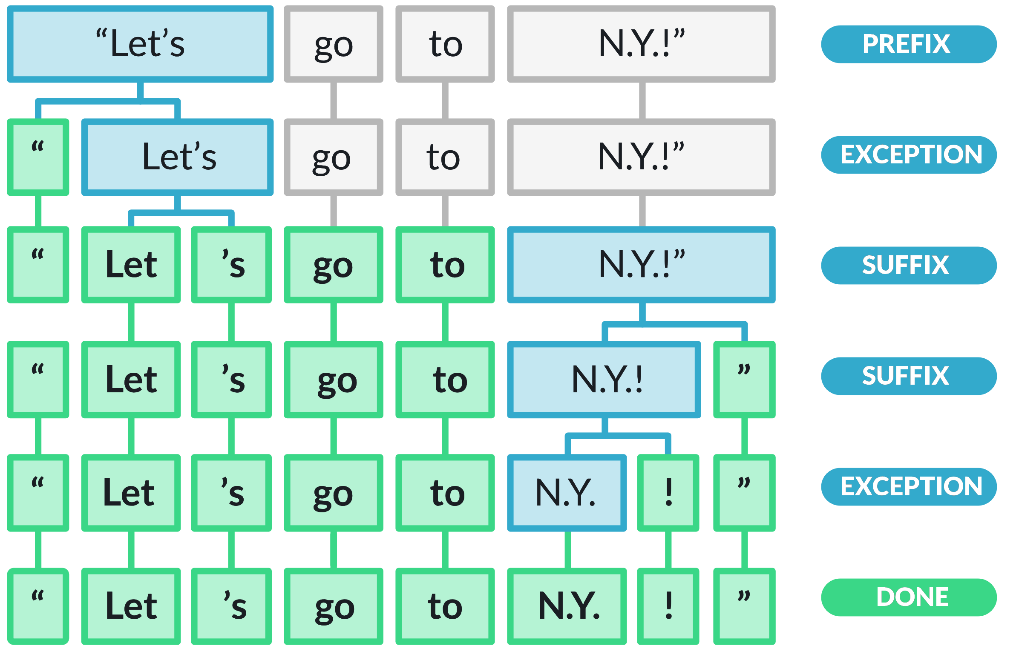
Rule-based word tokenizer.
Example: spaCy tokenizer (language specific).
Iterative tokenization starting from whitespaces and relying on manually curated rules.
Example: make punctuation marks their own token.
Source: “spaCy tokenizer”.

Slide 21
Token normalization.
Token normalization sacrifices information to reduce the number of unique tokens: sometimes good, sometimes bad.
Lemmatization:
Reducing a word to its “base” form, or lemma.
Examples: plural to singular (“cats” becomes “cat”); inflected verbs to verb root (“is” and “was” both become “be”).
Stop-words:
Language-specific high frequency words that usually carry less information.
Sometimes removed from documents.
Example English stop-words: {‘really’, ‘are’, ‘go’, ‘they’, ‘its’, ‘them’, ‘well’, ‘and’,…}.

Slide 22


Example tokenization process.
Word-based tokenization.
Stop-words removal.
Lemmatization.
“I have new books that I love.”
“I have new books that I don’t love.”
“book”, “love”
“book”, “love”

Slide 23
Text representation.

Slide 24
Text Representation: from tokens to vectors 1
Tokens are the first step to turn a text into numbers.
We can characterize a text based on the tokens it contains.
The challenge is to find meaningful numbers expressing the importance of each token for each document.
Problem: how to ensure we can also compare documents?

Slide 25
Text Representation: from tokens to vectors 2
We first create a “vocabulary”: the collection of unique tokens present in the whole corpus.
Now all texts can be described in reference to the same vocabulary.
If there are N unique tokens in the vocabulary, each text is described by an N-dimensional vector of token weights.

Slide 26
The Bag of Word model.

Slide 27
Bag of Words model.
A Bag of Word (BoW) model is a language model that treats each token as an independent feature:
It disregards the order of words in the document.
It assigns each token (or term) a weight that expresses how relevant each token is for a given text.

Slide 28
Document-term matrix
We represent a corpus with a Document-term matrix (for now, term=token)
Each row is a document.
Each column is a token (or term, from now on).
Each cell is a token weight for a given document.
Tokens as features.
Document ID | Token 1 | Token 2 | Token 3 | Token 4 | …
Doc_0001
Doc_0002
Doc_0003
Doc_0004
…
Documents as data points.

Slide 29
BOW model: example setup.
We have three documents:
Doc1: “Machine Learning is an interesting branch of computer science.”
Doc2: “Computer Science is a very interesting discipline.”
Doc3: “Machine Learning and Deep Learning are interesting disciplines.”
Pre-processed versions:
[‘machine’, ‘learning’, ‘interesting’, ‘branch’, ‘computer’, ‘science’].
[‘computer’, ‘science’, ‘interesting’, ‘discipline’].
[‘machine’, ‘learning’, ‘deep’, ‘learning’, ‘interesting’, ‘discipline’].
Vocabulary: {‘machine’, ‘learning’, ‘branch’, ‘computer’, ‘science’, ‘interesting’, ‘discipline’, ‘deep’}.

Slide 30
BoW model: Word count.
Term Frequency (TF) or counts:
A token weight is equal to the number of times it appears in a document.
Document ID | machine | learning | branch | computer | science | interesting | discipline | deep
Doc1 | 1 | 1 | 1 | 1 | 1 | 1 | 0 | 0
Doc2 | 0 | 0 | 0 | 1 | 1 | 1 | 1 | 0
Doc3 | 1 | 2 | 0 | 0 | 0 | 1 | 1 | 1

Slide 31
BoW model: sparsity.
The document-term matrix from a Bag of Words model is sparse.
With a large vocabulary, most entries in the matrix are 0.
* | * | 0 | * | 0 | 0 | 0 | * | 0 | 0 | * | 0 | 0 | 0 | 0 | 0 | 0 | 0 | 0 | 0 | 0 | 0 | 0 | 0 | 0 | 0 | 0 | 0
0 | 0 | 0 | 0 | 0 | 0 | 0 | 0 | 0 | 0 | 0 | * | * | * | * | 0 | 0 | 0 | 0 | 0 | 0 | 0 | 0 | 0 | 0 | * | * | *
0 | 0 | 0 | 0 | 0 | 0 | 0 | 0 | 0 | * | 0 | * | 0 | 0 | 0 | 0 | * | 0 | * | 0 | * | 0 | * | 0 | 0 | 0 | 0 | 0
A sparse matrix: the cell with the asterisk are the only entries different from 0.

Slide 32
BoW model: limitations.
A collection of individual tokens (called unigrams) ignores the order of and the relationship between words.
The documents “Alex eats food” and “food eats Alex” have the same representation in a Bag of Word model.
Collection of n-grams can help.

Slide 33
N-grams.
N-grams are are contiguous sequences of n tokens.
Bigrams: groups of two contiguous tokens.
Trigrams: groups of three contiguous tokens.
…
Using n-grams in a BoW model we can capture (some) word order information.
Example: “we are building machine learning models”.
Unigrams: {we, are, building, machine, learning, models}.
Bigrams: {we are, are building, building machine, machine learning, learning models}.
Trigrams: {we are building, are building machine, building machine learning, machine learning models}.

Slide 34
N-grams: example.
Documents: “Alex eats food”, “food eats Alex”.
Terms: unigrams and bigrams (after lemmatization).
{‘alex’, ‘eat’, ‘food’, ‘alex eat’, ‘eat food’, ‘food eat’, ‘eat alex’}.
Term Frequency based model:
Thanks to bi-grams, the two documents have different representations
Document ID | alex | eat | food | alex eat | eat food | food eat | eat alex
Doc1 | 1 | 1 | 1 | 1 | 1 | 0 | 0
Doc2 | 1 | 1 | 1 | 0 | 0 | 1 | 1

Slide 35
BoW model: more limitations.
The dimensionality of the document-term matrix (i.e. the vocabulary size) is very high.
Token normalization can help.
But with n-grams, the dimensionality can explode quickly.
Documents with similar meaning but different terms will not have similar representations.
“Stores were lowering prices to attract more customers” and “Shops were decreasing prices to appeal to more clients”: most words are different, but is their meaning similar?
Notes:
The pros of one-hot vectors: simple and require no implied ordering

Slide 36
Enter: the embedding.
Can we “embed” the document into a vector of numbers that capture its meaning as more than just keeping track of the words it contains?
We call this vector of numbers an “embedding”.
Embeddings:
Are learned from data.
Are dense, not sparse.
Are meant to capture the relevant information for the input they are representing.

Slide 37
Sparse vs dense.
A sparse vector representation has a higher dimensionality (that is, more entries overall), but most entries are 0.
A dense vector representation has a lower dimensionality, but most (or even all) entries are not 0.
* | 0 | 0 | 0 | 0 | 0 | 0 | * | 0 | 0 | * | 0 | 0 | 0 | 0 | * | 0 | 0 | 0 | 0 | * | 0 | 0 | 0 | 0 | 0 | 0 | 0
Representing a document as a sparse vector.
* | * | * | * | * | * | * | * | *
Representing a document as a dense vector.

Slide 38


Word embeddings.
Text embeddings started as representations for words, rather than entire documents.
Similar task: can we represent words using dense vectors that somehow “capture their meanings”?
Walking
Walk
Book
Run
Books
Running

Slide 39
Word embeddings: how?
Embeddings are learned from data.
We define an embedding model and a language understanding task to solve.
Each model is a specific way of linking words to embeddings.
The resultant word embeddings are those that maximise performance on that task.
Example word embedding model: Word2Vec model.
The language task is “predicting a missing word from the context”.

Slide 40
Pre-trained word embeddings.
But how do *we* get the word embeddings?
There are already existing word embeddings that someone else already trained.
These are called pre-trained word embeddings.
A publicly available procedure/model to go from a sequence of words to a sequence of vectors.
For some models, this is just a look-up table.

Slide 41
Brief note on social impact.
At its core, text analytics is about finding patterns in text data.
Many techniques build on a tradition of “ready-made” techniques trained on large existing datasets.
Whose patterns?
Whose data?
Datasets scraped from the internet.
Who is more/less represented on the internet?
With scale also comes “ignorance”.
English language (global north “version”) is over-represented.

Slide 42
Python tutorial.

Slide 43
How to access the tutorial.
Go to https://github.com/sg4gre.
Click on the tab called “gre_text_analytics_seminar”.
Click on the “launch Binder” button (and wait a few minutes).
If you know what you are doing, you can clone the repo and install the requirements using Anaconda and python version 3.10.

Slide 44
Today’s task: gender in tv tropes.
We will reproduce some of the analysis steps to identify gender bias in TV tropes.
Big limitations: binary and stereotypical gender.
Disclaimer: this is a crowd-sourced dataset about narrative stereotypes.
Outlook is more critical than expected, but still about stereotypes.
I’ve done some pre-cleaning to remove some of the tropes, also to make the data more manageable.
Any issues, please do let me know.

Slide 45
What is Python?
Python is a very versatile programming language.
Python is open-source and free.
Python comes with some standard functionalities, but many more can be added.
By installing libraries (or packages).
Libraries, and different versions of python, can be managed using Anaconda.

Slide 46
How to follow along.
We work with python by creating and manipulating variables using pre-made or custom-made functions.
Every line that starts with “#” is a comment where I try to explain what is going on.
Mostly, lines are in this format:
Something = Something else.
“Something else” (right hand side) is where we manipulate existing variables.
“Something” is the variable where we store the result of “Something else”.

Slide 47
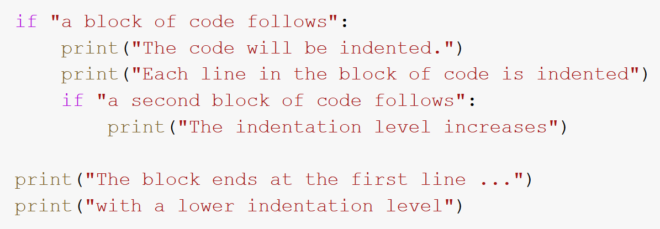
Things to remember about python 1.
Whitespaces and indentation matter:
Python uses indentation/whitespace and the colon “:” to indicate blocks of code.
Everything that is indented coming after a colon needs to be read as a group.
First indentation block
Second indentation block

Slide 48
Things to remember about python 2.
Important keywords are:
“for” (to create loops).
“if” (to create conditional statements).
“def” (to create functions).
“print()” (it will show on the screen whatever is inside the parenthesis).
“import” (to make further packages available within the script).
You will often see the “dot notation”, which consists of a variable followed by a period (e.g. “data.mean()”).
Anything after the period is a function or an attribute of the variable that we can do something with.

Slide 49
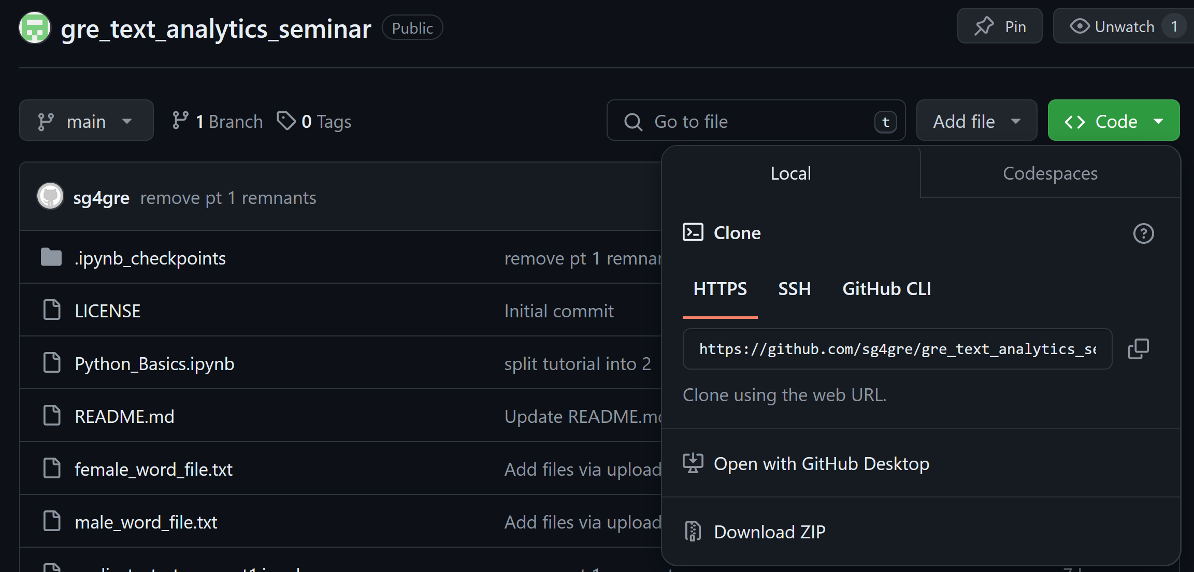

Backup access plan
Go: https://github.com/sg4gre.
Click on the tab called “gre_text_analytics_seminar”.
Click on the tab “code”, then “Download Zip”.
Unzip the folder.
We’ll use Anaconda to prep python.

